Slide 1
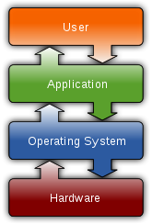
WHAT IS OPERATING SYSTEM
An operating system (OS) is system software that manages computer hardware and software resources and provides common services for computer programs.
For hardware functions such as input and output and memory allocation, the operating system acts as an intermediary between programs and the computer hardware.
There are many operating systems such as macOS, Linux, and Microsoft Windows.

Slide 2
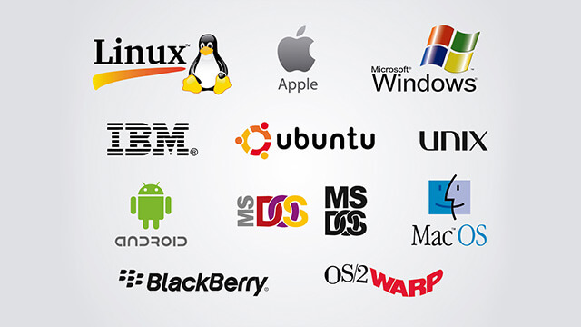
TYPES OF OPERATING SYSTEM
Real-time operating systems (RTOS)
Single-user, single-task
Single-user, multi-tasking
Multi-user

Slide 3
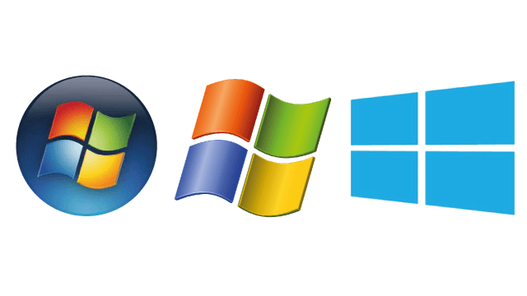
WINDOWS OPERATING SYSTEM
Windows OS, computer operating system (OS) developed by Microsoft Corporation to run personal computers (PCs).
Featuring the first graphical user interface (GUI) for IBM-compatible PCs, the Windows OS soon dominated the PC market.

Slide 4

ADVANTAGES OF WINDOWS OS
Ease of use.
Available software.
Backwards compatibility.
Support for new hardware.
Plug & Play.
Games.
Compatibility with MS driven websites.

Slide 5

DISADVANTAGES OF WINDOWS OS
High resource requirements.
Closed Source.
Poor security.
Virus susceptibility.
Outrageous license agreements.
Poor technical support.
Hostile treatment of legitimate users.
Extortionist prices.
Additional expenses.
Poor stability.
Poor remote access.
Backwards incompatible file formats.
Poor support for older hardware.
High Total Cost of Ownership (TCO).

Slide 6
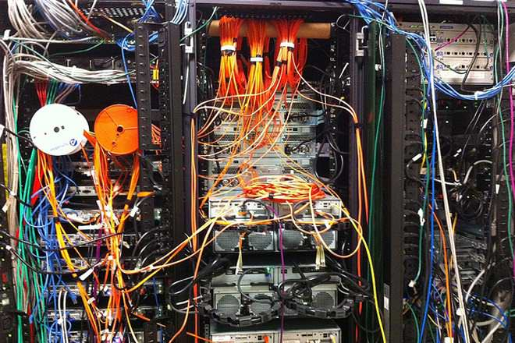
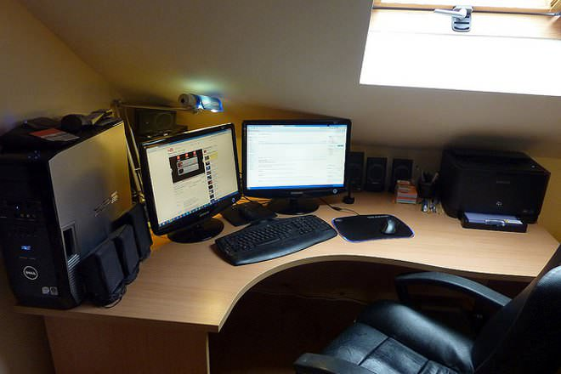
Windows Workstation vs Windows Server
Windows Server Supports More Memory.
Windows Server Uses CPUs More Efficiently.
More Network Connections Allowed on a Windows Server.
The Server OS is Configured for Background Tasks.

Slide 7
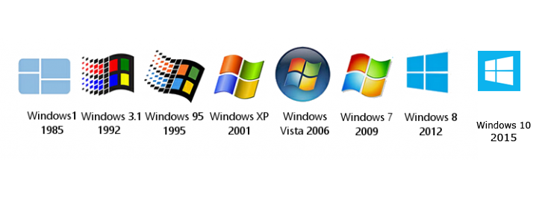
Versions of Windows Workstation

Slide 8
Versions of Server OS
Windows Server 2003 (April 2003)
Windows Server 2003 R2 (December 2005)
Windows Server 2008 (February 2008)
Windows Server 2008 R2 (July 2009)
Windows Server 2012 (August 2012)
Windows Server 2012 R2 (October 2013)
Windows Server 2016 (September 2016)
Windows Server version 1709 (September 2017)

Slide 9
Features of Windows 7 and Server 2008 R2
Direct Access
Read only Distributed File System (DFS)
Desktop and Application Feeds
Agile VPN
Offline Folders enhancements
AppLocker
RDP 7

